Slide 1
Course - DT228/1
Information Technology Fundamentals
MANAGING INFORMATION TECHNOLOGY COMPLEXITY

Slide 2
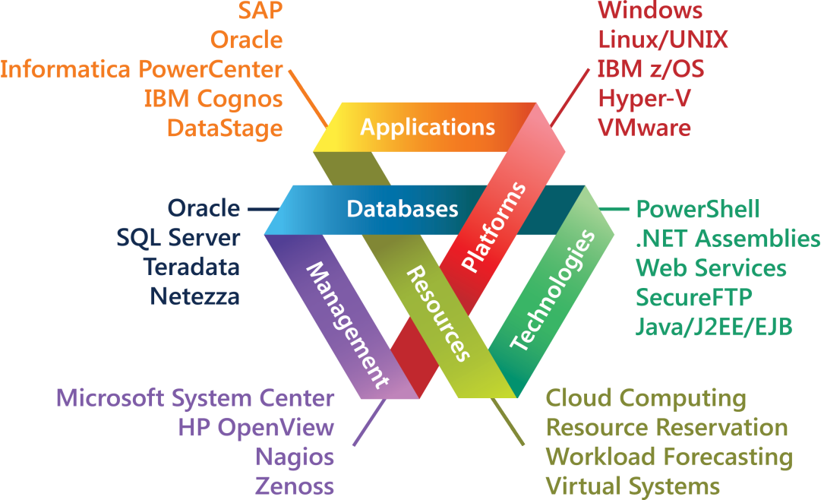
What is I.T. Complexity?
The intermeshing or entanglement of hardware, software, networks and other parts of systems makes information technology complex.

Slide 3
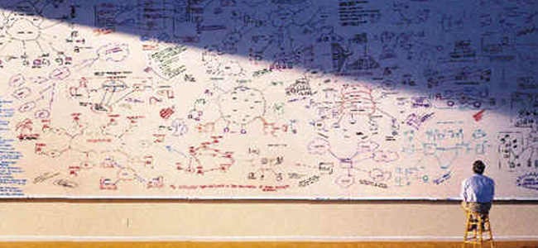
What is I.T. Complexity? (2)
The more that is contained in a system, the more complex it is: PDA or tablet... out to the cloud(s).

Slide 4
What Makes I.T. Complex?
For example, with data, the:
volume
velocity
variety
causes complexity and expense for a user or organisation.
The hardware and software that support the data will have their own levels of complexity.

Slide 5
What Makes I.T. Complex? (2)
The paths of functionality through hardware and software reflect information technology complexity.
Was the complex system built on the basis of recommendations and specification (from a systems analyst, for example), or did evolve?
Is the complexity necessary – or is it an unfortunate side effect from bad design or legacy systems?

Slide 6
What is Wrong with Complexity?
Complexity in information technology needs to be managed as it can foster unpredictability.
Unpredictable systems are often inefficient – or a liability.
At best they cause expense to maintain control of the way that they work. Consider the testing and error checking required for a system that is ‘out of control’.

Slide 7
Chaos, Unpredictability, Complexity
Chaos describes complete disorder and disarray.
This is outside complexity, but there is a strong connection.
In physics, chaos is described as ‘behaviour so unpredictable as to appear random.’
Chaos in information technology is to be avoided. Control is what you want – but there can be complexity with control.

Slide 8
Hardware Complexity
The significance of development of planning and implementing hardware designs is enormous, as the complexity of hardware is growing.
This complexity is not linear but exponential – consider Moore’s Law: that the number of transistors per square inch on integrated circuits have doubled every year since their invention.
(Said by Gordon Moore of Intel, around 1965)

Slide 9
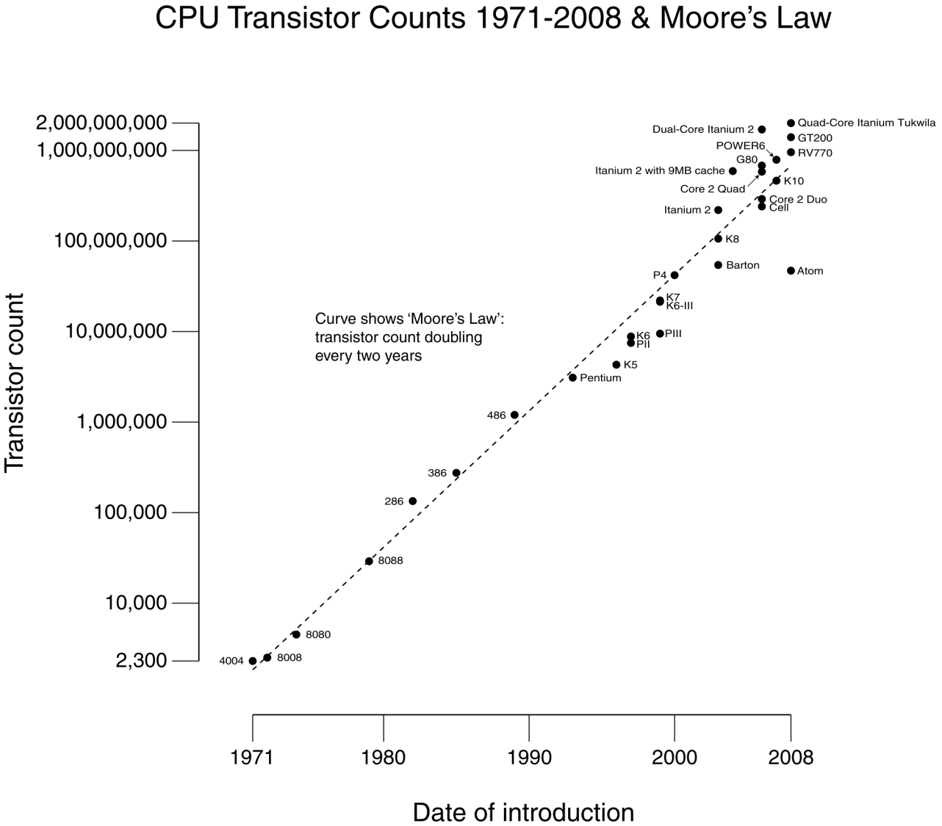
Hardware Complexity (2)

Slide 10
Hardware Complexity (3)
The multi-core argument:
Build many small CPU cores.
The small cores are enough to optimise low-ILP (low instruction-level-parallelism) programs (i.e. high throughput with multiprogramming).
For high-ILP programs, the compiler parallelises the application into multiple threads, and since the cores are on a single die the cost of communication (in engineering terms, rather than monetary terms) is affordable.

Slide 11
Hardware Complexity (4)
Try to make one device (such as a personal computer) do many things, and then complexity increases.
Today the PC has become more complex due to the devices that it can support, and the software that can be run on these machines.
The GUI (Graphical User Interface) has developed to ‘cover up’ the complexity of a PC.

Slide 12

Hardware Complexity (5)
Hardware designs must meet a complex set of functional and performance requirements. Above all, designs are increasingly required to support additional configurability options in order to meet the changing demands of system and application designers. Configurability adds to the ever increasing complexity of hardware designs.

Slide 13
Software Complexity
Software complexity might be based on the following factors:
The number of variables defined and used in a software system.
The number of arguments (parameters) involved in each function call in the source code.

Slide 14
Software Complexity (2)
Software complexity is usually viewed in terms of functionality: the more functions in the source code, the more complex the software will be.
Software is made more complex by having many of these programs linked to each other. For example, function calls from a main program to other programs (modules or objects).

Slide 15
Software Complexity (3)
A source code which utilises more variables is harder to understand, maintain, and migrate.
Considering most modern programming languages are strong typed, coding for complex programs requires more attention regarding:
initialisation
type checking
type conversion
value tracking
deconstruction

Slide 16
Using Metrics
What is a metric?
“A system or standard of measurement.”
A software metric is a standard of measure of a degree to which a software system or process possesses some property. Even if a metric is not a measurement (metrics are functions - measurements are the numbers obtained by the application of metrics), often these terms are used synonymously.
(wikipedia)

Slide 17
Software Complexity (4)
Software complexity metrics
You can measure certain aspects of the software (lines of code, number of if-statements, depth of nesting…)
Then you can use these numbers as criteria to assess a design, or to guide the design.
The interpretation of metrics is that higher value ⇒ higher complexity ⇒ more effort required (= worse design - possibly).

Slide 18
Software Complexity (5)
Size based complexity measures:
counting lines of code (intra-modular)
There will be differences in scale for different programming languages
Halstead’s metrics: counting operators and operands:
n₁: number of unique operators
n₂: number of unique operands
N₁: total number of operators
N₂: total number of operands

Slide 19
Software Complexity (Example Program)
public static void sort(int x []) {
for (int i=0; i < x.length-1; i++) {
for (int j=i+1; j < x.length; j++) {
if (x[i] > x[j]) {
int save=x[i];
x[i]=x[j]; x[j]=save
}
}
}
}
operator, 1 occurrence
operator, 2 occurrences

Slide 20
Software Complexity (Example Program) (2)
public static void sort(int x []) {
for (int i=0; i < x.length-1; i++) {
for (int j=i+1; j < x.length; j++) {
if (x[i] > x[j]) {
int save=x[i];
x[i]=x[j]; x[j]=save
}
}
}
}
operand, 2 occurrences
operand, 2 occurrences

Slide 21
Software Complexity Metrics
Size of vocabulary: n = n₁ + n₂
Program length: N = N₁ + N₂
Volume: V = N log₂n
Level of abstraction: L = V*/ V, V*=volume of prototype. For sort(x), V* = 2 log 2. For main(), L is high.
approximation: L’ = (2/n₁)(n₂/N₂)
Programming effort: E = V/L
Estimated programming time: T ’ = E/18
Estimate of N: N ’ = n₁log₂n₁ + n₂log₂n₂

Slide 22
Software Complexity Metrics (2)
Does the proposed metric really reflect the complexity degree of the programs?
Through a series of experiments and tests, the proposed measure can be evaluated.
EG, Evaluating the complexity index and studying the difference between different revisions.
The revisions of the sample programs may show that they can provide the same functionality, but the code can be simplified.

Slide 23
Network Complexity
Complex information technology networks are the supportive structure of complex systems.
Every complex system is a network of interaction among numerous smaller elements.
Some networks are geometric or regular in place, others contain long-range connections - or are not spatial at all.

Slide 24
Network Complexity (2)
Network anatomy is important to characterise because a network’s structure affects function (and vice-versa).
Examples:
The structure of social networks -
control the spread of information (such as marketing, fads, rumours, etc.)
The structure of the Internet -
one must understand the robustness and stability of data transmission.

Slide 25
Network Complexity (3)
Network metrics:
Average path length (What is the distance between interactive nodes, on average?)
Degree distribution (Connectivity – how many nodes are interconnected?)
Clustering coefficient (How much is it possible to gather commonly connected nodes?)

Slide 26
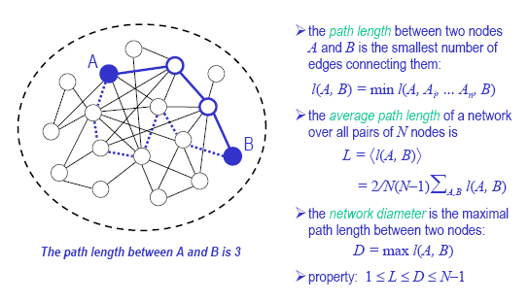
Average Path Length

Slide 27
Degree Distribution

Slide 28
Clustering Coefficient

Slide 29
Network Evolution

Slide 30
Network Complexity Overview
Structural complexity:
The topology – how the network is laid out.
Network evolution:
Networks can change over time – EG add nodes.
Connection diversity:
Links can have directions, weights or signs.

Slide 31
Network Complexity Overview (2)
Dynamical complexity:
Nodes can be complex nonlinear, dynamical systems – they do not have to follow very specific designs.
Node diversity:
There can be different kinds of nodes – consider a Linux machine, a Windows machine and an iOS machine interlinked.

Slide 32
Managing Complexity
How do we manage technology within an environment?
How can we find the appropriate response to a given environmental situation?
The first step:
differentiate between states of the environment.
Being able to differentiate between environmental states means that information can be gathered about the environment.

Slide 33
Managing Complexity (2)
It is important that the observer (analyst?) is able to make a choice, and use the criteria for differentiation to choose between the possible states of the environment.
On the basis of this choice the observer provides the appropriate response to complexity of technology (or systems).
(States of environment := system design options)

Slide 34
Managing Complexity (3)
So the analyst must be informed -
Information is the difference that makes a difference.
How?
Systems analysis?
It is as good as any (or better)!

Slide 35
Managing Hardware Complexity
There may need to be an assessment of development, procurement and sustainability of hardware.
This requires the balancing of four separate aspects of total hardware system ‘value’.
Performance of the hardware
Operational Availability (OA)/Logistics
Reliability
Life Cycle Cost (LCC)

Slide 36
Managing Hardware Complexity (2)
There may be a metrics equation to measure hardware value.
Objectives set in the value equation might include:
Maximise performance
Maximise operational availability
Optimise the logistics support strategy
Maximise reliability
Minimise Life Cycle Cost (LCC)

Slide 37
Managing Hardware Complexity (3)
Methodological example: SEER for hardware
SEER, which comes from ‘having the ability to foresee the future’, relies on parametric algorithms (limited number of design possibilities), knowledge bases, simulation-based probability and historical precedents to allow project managers, engineers and cost analysts to accurately estimate a project's cost schedule, risk and effort before the project is started.

Slide 38
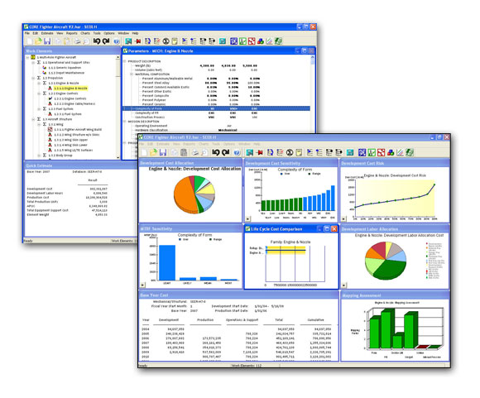
Methodological Example
SEER for Hardware screen shots

Slide 39
Another Methodological Example
Hardware Description Language
In electronics, a hardware description language (HDL) is a specialised computer language used to program the structure, design and operation of electronic circuits, and, most commonly, digital logic circuits.

Slide 40
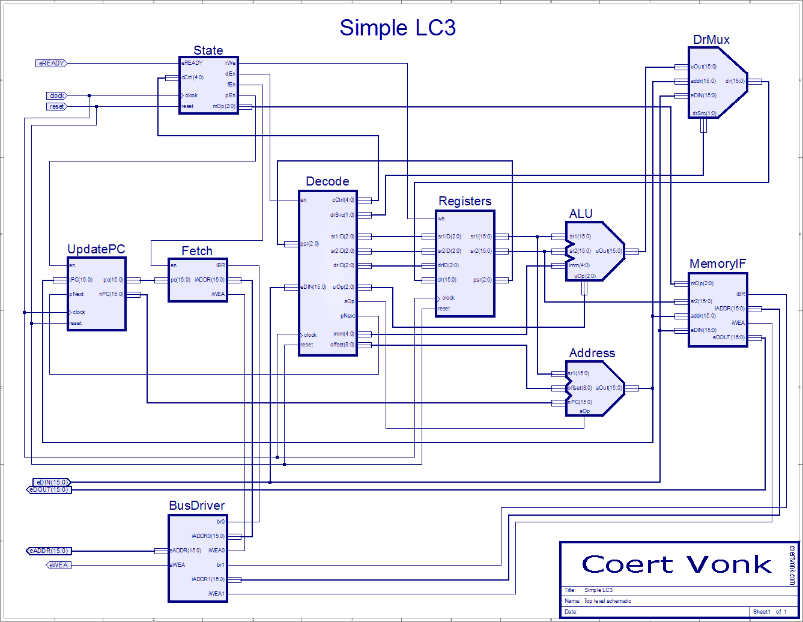
Describing Hardware with HDL

Slide 41
VHDL
VHDL (VHSIC Hardware Description Language) is a hardware description language used in electronic design automation to describe digital and mixed-signal systems such as field-programmable gate arrays and integrated circuits.
VHDL can also be used as a general purpose parallel programming language.

Slide 42
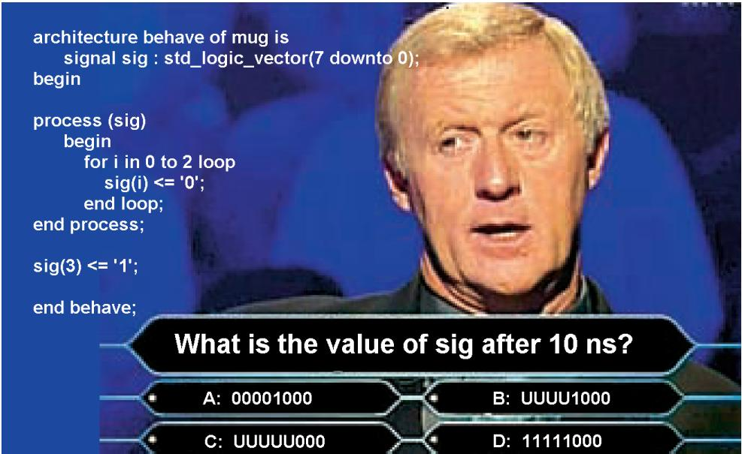
VHDL (2)

Slide 43
Managing Software Complexity
A key aspect of software design is understanding that the goal is to achieve the requirements in the face of the limitations of human involvement, balanced with the need for software teams to develop software.

Slide 44
Managing Software Complexity (2)
Edsger Dijkstra on software complexity:
“The technique of mastering complexity has been known since ancient times: divide et impera (divide and rule).
… I assume the programmer’s genius matches the difficulty of his problem and assume that he has a arrived at a suitable subdivision of the task.”

Slide 45
Managing Software Complexity (3)
Software methodologies:
Agile Software Development
Best practice
Extreme programming (XP)
Scrum Pattern (related to Agile)
SSADM (Structured systems Analysis and Design Methodology)
SSM (Soft Systems Methodology) (related to Multiview)
Waterfall model
... And MANY more...

Slide 46
Up Next
Next week’s lecture title is:
Information Technology Disciplines

